Slide 1
DATASCI 207: TripAdvisor Hotel Reviews
Datasci 207 Kevin Yi, Kritin Nandish, Patrick Abousleiman, Thrishna Bhandari
Notes:
Hello everyone today our team will be presenting our project on using machine learning to predict Tripadvisor hotel ratings.

Slide 2
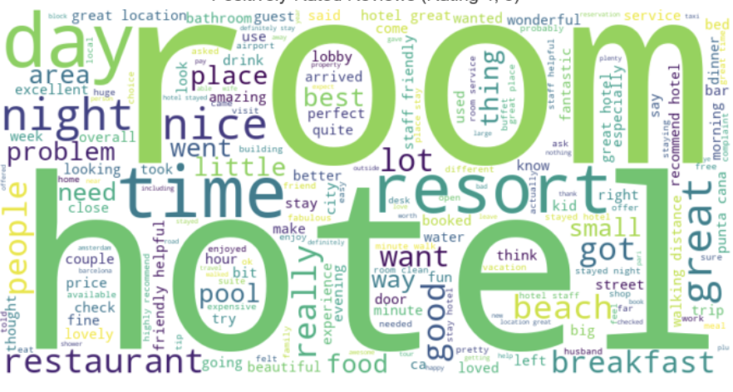
Motivation
Question: Can we create a model that will accurately predict whether a hotel rating is positive or negative?
Motivation: Hotels are the most popular travel accommodations and hotel ratings lack standardization
Existing Work: AI generated responses to hotel reviews
Approach: We will build several models using different techniques to find the one with the highest classification accuracy
Results: We created several strong models with high classification precision, recall, and AUC
Notes:
The central question for this project is “Can we create a model that will accurately predict whether a hotel rating is positive or negative based on the review produced by a Tripadvisor user?”
The reason we decided to pursue this topic is because hotels still remain the most popular form of accommodation for travellers despite the rise in alternatives like Airbnb.
There is also a lack of standardization in hotel ratings since semantically similar reviews may be awarded different star ratings by different users.
We’ve found that previous work had been done in the AI hotel review space with several platforms designed for hotel management that use AI to respond to customer reviews on internet. However it doesn’t seem like there is a major platform that uses machine learning to standardize ratings based on user reviews.
Our approach to answering this question followed several steps. We began by importing and cleaning our Tripadvisor review dataset to make it useful for our analysis. We then conducted some basic EDA to determine the distributions of various features in our dataset. From there we built 7 different models using different machine learning techniques and analyzed each one to determine the most accurate one for our use case.
By the end of the project we were able to create several models with high precision, recall, and AUC values that performed well at predicting whether reviews were positive or negative.

Slide 3
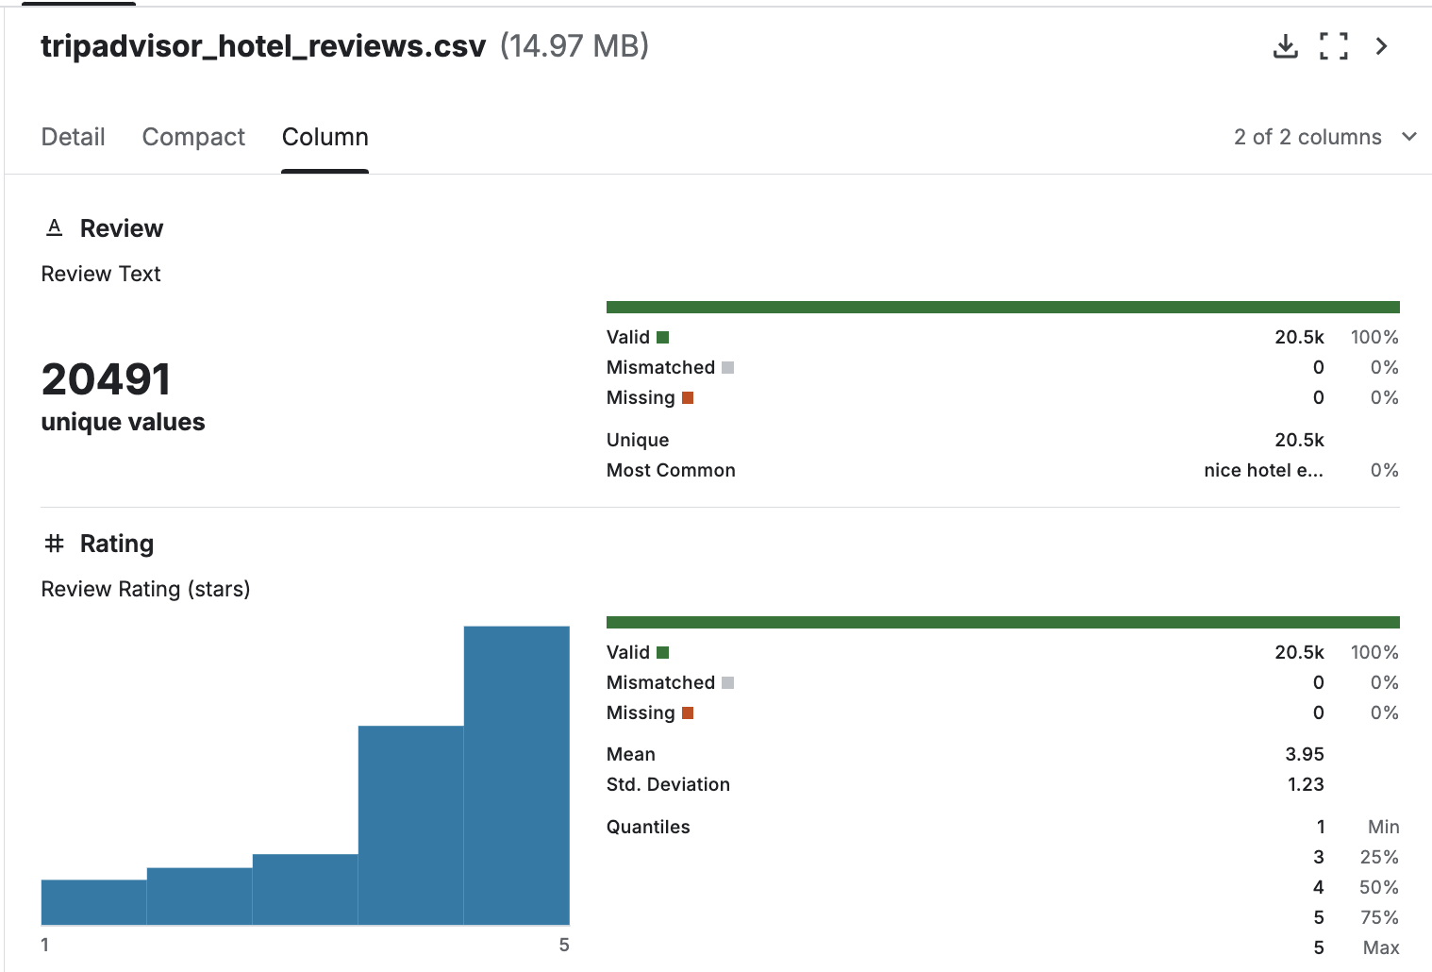
Data Overview
TripAdvisor dataset from Kaggle
Users provide reviews for hotel experience on locations and provide numeric reading from 1-5 stars
2 features, 20,491 rows: 1. User review (string) 2. User rating (numeric)
Objective: Predict if a hotel review is positive (rating of 4+) or negative (rating of 3 or below) based on user review

Slide 4
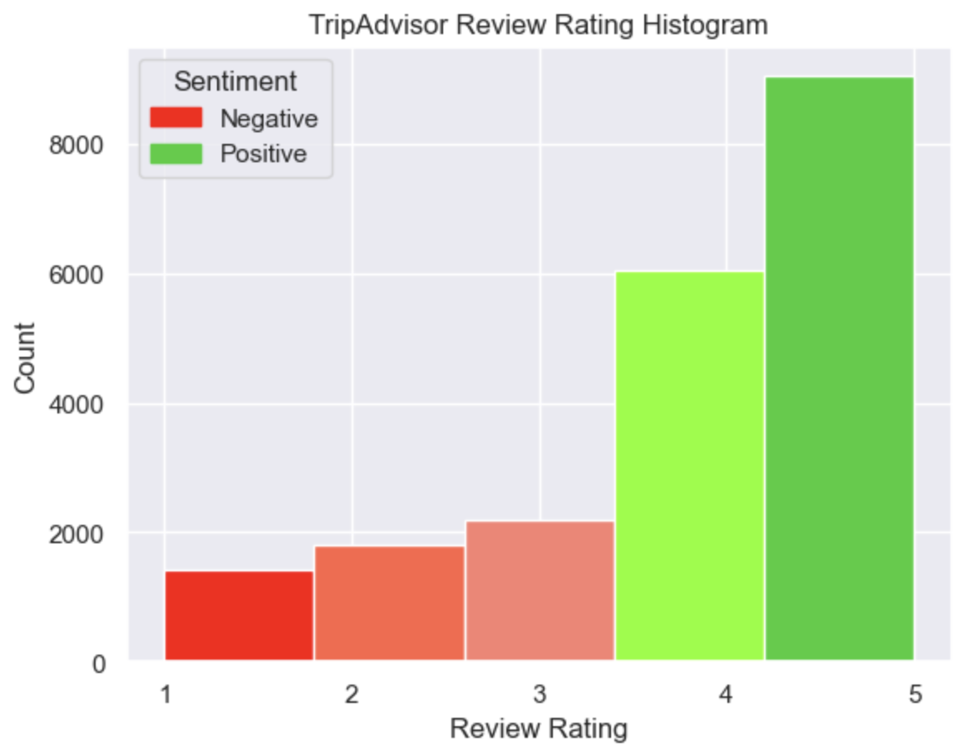
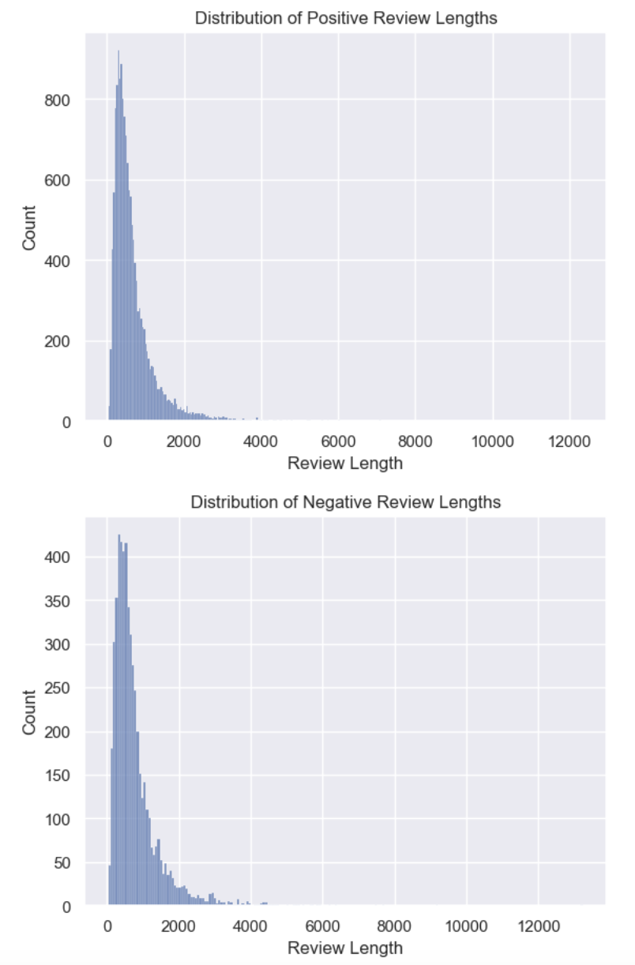
Data Processing
Preprocessing steps:
Imported data
Checked for null/missing values
Feature Engineering
Convert all text to lowercase
Extract emoticons + clean
Remove non-word characters
Handle contractions
Expand contractions to full length words (can’t -> cannot)
Tokenize data with 5000 most common words
Padded data to length of 1000 characters
Data Split:
Positive Labels: Reviews with Rating 4 or 5 → Label = 1
Negative Labels: Reviews with Rating 1, 2, or 3 → Label = 0
Training-Testing-Validation split: 60-20-20%

Slide 5

Model 1: The Baseline
Implemented a baseline model with our majority class
We chose positive reviews (classification of 1)
Metrics to Beat:
Precision: 0.7272, Recall: 1.0000, AUC: 0.5000

Slide 6
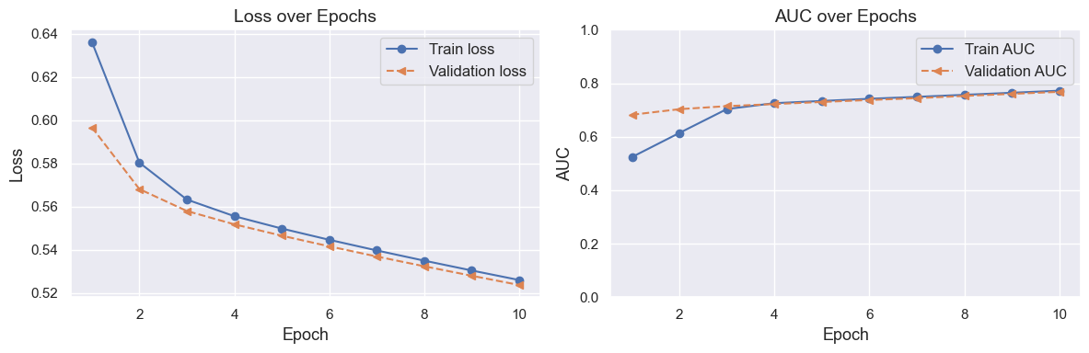
Model 2: One-Hot Encoding
Parameters:
Limited Vocab: 1000 (due to memory issues)
Max length had to be set to 100
Batch size: 32
Epochs: 10
Our threshold was set to 0.5
Under 0.5 was negative reviews
Over 0.5 was positive reviews

Slide 7
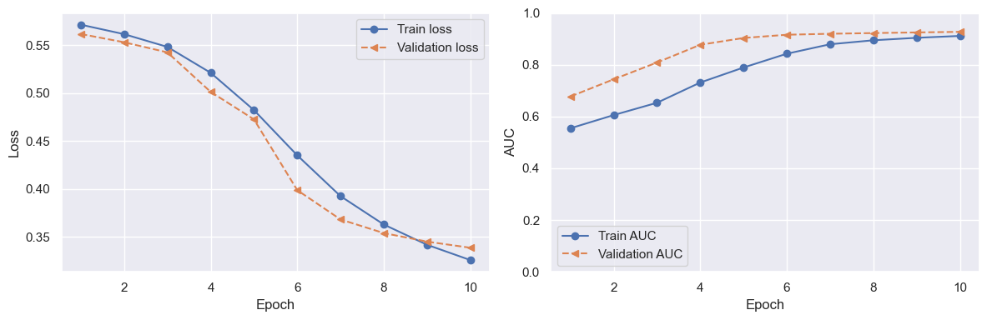
Model 3: Embeddings
Parameters:
Vocab size: 5000
Sequence length: 1000
Batch size: 32
Epochs: 10
We saw great improvement in this model over the one-hot encoding
Metrics:
Test Loss: 0.34144753217697144
Test recall: 1.0
Test AUC: 0.9263582229614258
Test Precision: 0.9216826558113098

Slide 8
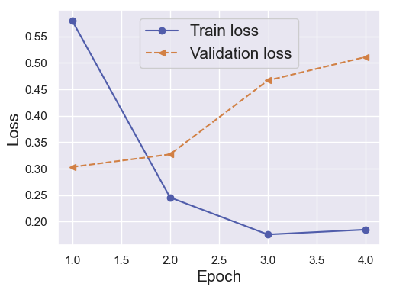
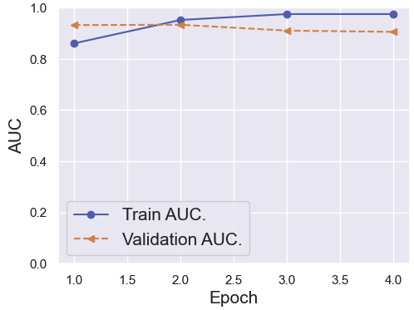
Model 4: CNN
Vocab Size | Review Length | Epoch | Batch Size | Learning Rate
5000 | 1000 | 10 | 32 | .001
Input
Embedding: 64
(4x4) kernel x 12
Maxpooling 2
Dropout 30%
Flatten
Sigmoid Classifier
Notes:
In this model we’ve created a convolutional neural network with an embedding layers.
Similar to the prior model, we used similar hyperparameters. Ultimately, the AUC, recall and precision was barely lower than what was previously achieved.
We also chose to add Embedding layer of 64, 12 4x4 kernels, pooling, dropout, flattening, and classification layers to the model before returning the final compiled output.

Slide 9
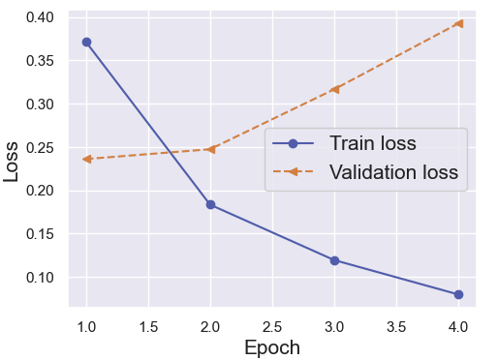
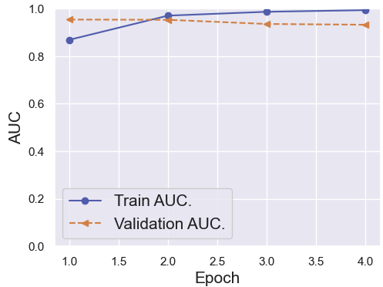
Model 5: CNN with hypertuning
Vocab Size | Review Length | Epoch | Batch Size | Learning Rate
5000 | 800 | 10 | 32 | .0005
Maxpooling 2
Input
Embedding: 50
(3x3) kernel x 64
(3x3) kernel x 32
Maxpooling 2
Maxpooling 2
Dropout 25%
Flatten
(5x5) kernel x 64
Sigmoid Classifier
Notes:
Despite the high AUC of our first CNN and logistic model with embedding, we wanted to see if we could improve upon by altering the hyperparameters in order to maximize the model's performance. In this iteration, we’ve incorporated a hyperparameter tuning function to change the hyperparameters of the model in order to find the ideal values for the different hyperparameters that the model will be built with. The final model selected is a 3 Convolutional layer model. The result is a model that had similar performance as the previous two models. I suspect that the hyperparameter training steps were too large.

Slide 10
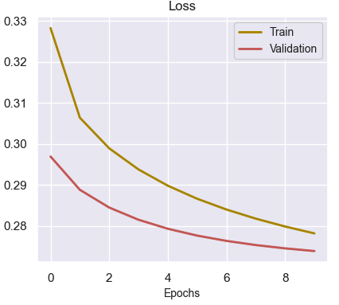
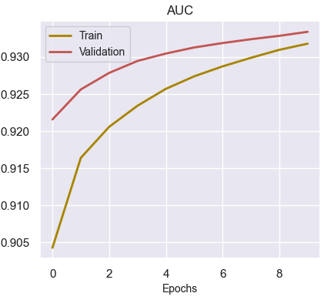
Model 6: Transfer Learning from Transformer Model
Vocab Size | Review Length | Epoch | Batch Size | Learning Rate
30000 | 300 | 10 | 32 | .001
Input
Extracted Embedments from Pretrained DistillBert Model fine tuned on SSt-2
Dense Sigmoid Classifier
Notes:
pre trained distilbert-base-uncased-finetuned-sst-2-english transformer model and extract its embedding and place a dense classifier layer. Essentially We used the pre trained sentence embeddings to classify the sentiment of travel reviews. This model is a fine-tune checkpoint of DistilBERT-base-uncased, fine-tuned on SST-2 sentiment tasks. DistilBert uncased is a light weight version of BERT and trained on lower cased words. SST2 is 11,855 single sentences extracted from rotten tomatoes movie reviews parsed with the Stanford parser and includes a total of 215,154 unique phrases from those parse trees, each annotated by 3 human judges

Slide 11
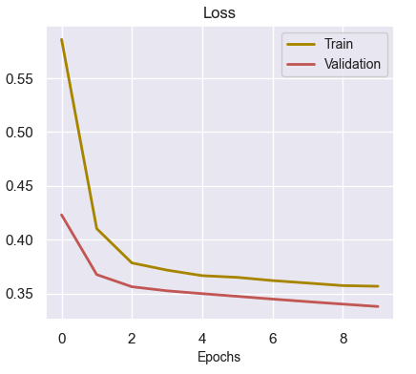
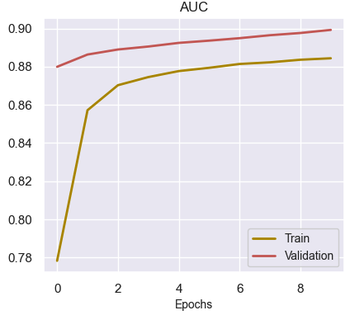
Model 7: Fine Tuning Transformer Model
Vocab Size | Review Length | Epoch | Batch Size | Learning Rate
30000 | 300 | 10 | 32 | .00001
Input
Fine tune Embedments from Pretrained DistillBert Model fine tuned on SSt-2
Dense Sigmoid Classifier
Notes:
In model 7, we seek to fine tune the distilbert-base-uncased-finetuned-sst-2-english even further with our travel data instead of just feature extracting and training the top dense layer like we did for model 6. Fine tuning the model with our data reduced the performance of the model.

Slide 12
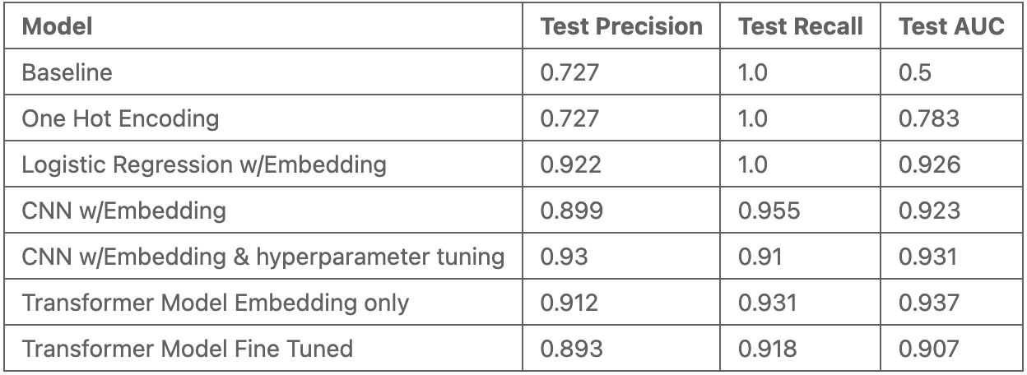
Conclusions
Explored different models to evaluate Precision and Recall.
Multiple models performed well under similar parameters.
One-hot encoding was the least precise and had lowest AUC
Future research could build a multiclass classification model to predict exact ratings and further tune hyperparameters
Notes:
Throughout this project we’ve explored different types of models and their abilities to precisely classify reviews in this dataset. From our baseline to the final transformer model we’ve seen how including certain features can significantly improve predictive performance.
After trying several models we’ve determined that the convolutional neural network with hyperparameter tuning was the most precise for this use case. This model included several useful layers and optimally tuned hyperparameters that yielded the highest balance of precision and recall while also minimizing loss for our test data.
Other models that performed very well were the CNN without hyperparameter tuning, logistic regression with embeddings, and the transformer model without hyperparameter tuning. The transformer model with no fine tuning also had the highest AUC value relative to the baseline and other models.
Our tests also showed that the one-hot encoding model was the least effective with no improvement in precision over the baseline model. This may be due to the fact that we had to reduce the vocabulary size for this model since one-hot encoding is very memory intensive.
In a future project it may be interesting to create a model that can employ multiclass classification to predict the exact star rating of hotels instead of just whether the rating is positive or negative. This could help further improve rating reliability and help travellers when booking their next place to stay.
Thank you so much for time we will now answer any questions you may have.

Slide 13
Thank you!

Slide 14
Contributions
Thrishna Bhandari - Data Processing and Exploratory Data Analysis
Kevin Yi - Data Processing, CNN and Transformer Modelings, Write ups.
Kritin Nandish - Baseline Model, One Hot Encodings, Embedded Model
Patrick Abousleiman - Write Up and Analysis

Slide 15
NeurIPS Paper Checklist Guidelines
Yes
Yes
No
Yes
N/A
Yes
Yes
No
Yes
Yes
Yes
No
No
Yes
N/A

Slide 16
Resources & Citations
https://www.statista.com/chart/33087/vacationers-who-booked-various-accommodation-types/
https://ir.tripadvisor.com/news-releases/news-release-details/travelers-push-tripadvisor-past-1-billion-reviews-opinions
https://www.mara-solutions.com/

